Slide 1
Telecom customer churn

Slide 2
01 introduction
02 RESULTS ANALYSIS
03 data preprocessing
04 the end
Introdution about our dataset and dataset content
Answer the questions using the data
agenda
Data preprocessing and handle missing
The end of this presintation

Slide 3
01. INTRODUCTION
Introduction about our dataset and dataset content

Slide 4
INTRODUCTION
The Customer Churn table contains information on all 7,043 customers from a Telecommunications company in California in Q2 2022
Each record represents one customer, and contains details about their demographics, location, tenure, subscription services, status for the quarter (joined, stayed, or churned), and more.

Slide 5
Data content
38 Feature X 7043 Row
Customer Attributes | (Customer ID, Age, Married, number of dependents, City, etc…) | 11 Feature
Company services | (Internet Service, Online Security, Streaming Movies, Streaming TV, etc…) | 18 Feature
Company benefits | (Monthly Charge, Total Refunds, Total Revenues, etc…) | 6 Feature
Churn situation | (Customer Status, Churn Category ,Churn Reason) | 3 Feature

Slide 6
02. RESULTS ANALYSIS
Answer the questions using the data

Slide 7
Questions
q1 What is the most important category for churn?
q2 Churn reasons?
q3 Gender effect on churn?
q4 the top 10 cities Total revenue?
q5 what is the churn situation of top 5 cities revenue?
q6 How are the offers affected the churn situation?
q7 Services effect on churn situation?
q8 Most common age?
q9 internet type effect on customer satisfaction and revenue?

Slide 8
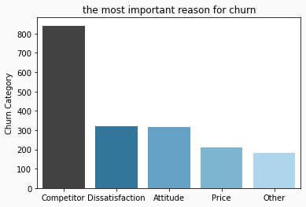
It seems that main reason for churn is that the company is not able to compete with opponent companies
q1 What is the most important reason for churn?

Slide 9
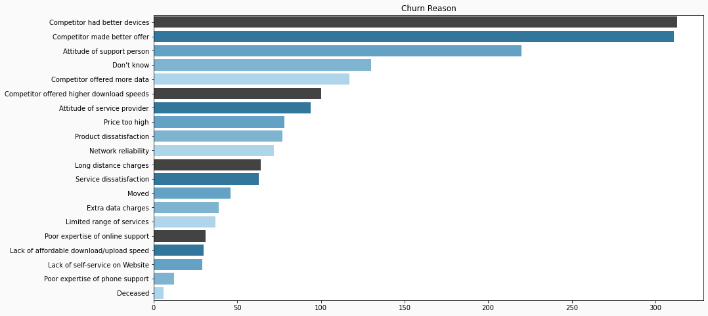
It seems that also Attitude of support person is a reason for churn
q2 Churn reasons?

Slide 10
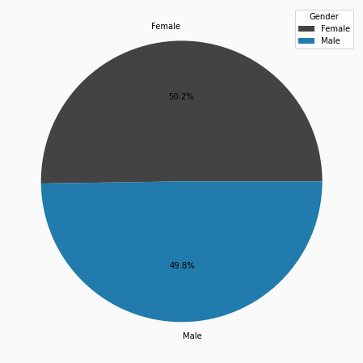
It seems that gender-based does not affect data distribution.
q3 Gender effect on churn?

Slide 11
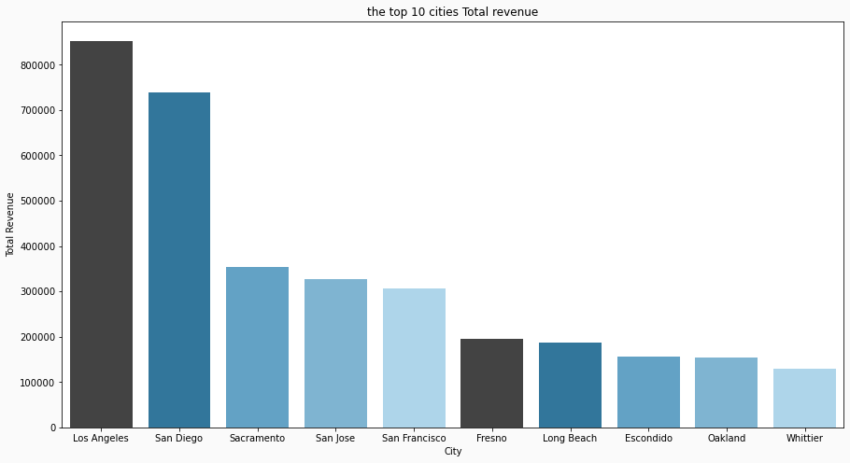
q4 the top 10 cities Total revenue?

Slide 12
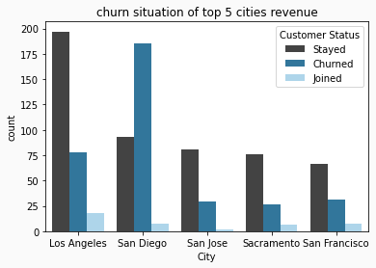
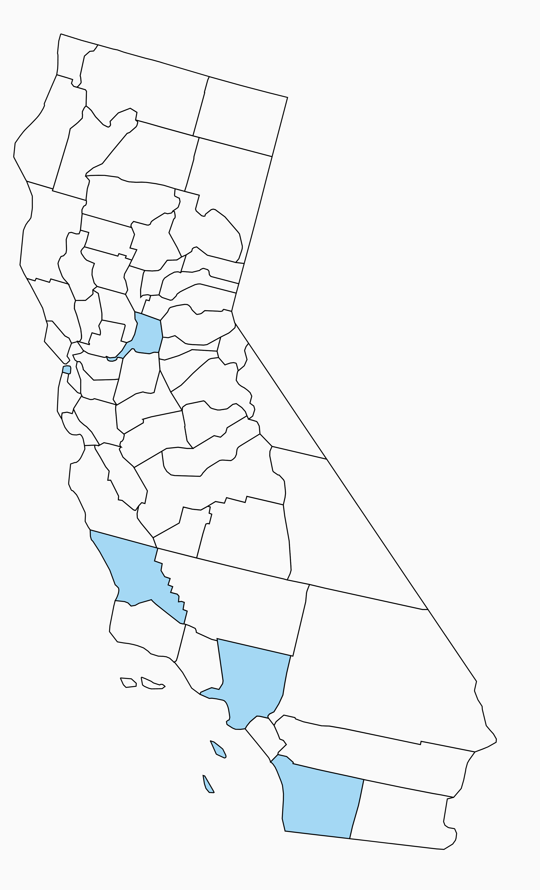
It seems that company has a problem in San Diego
q5 what is the churn situation of top 5 cities revenue?

Slide 13
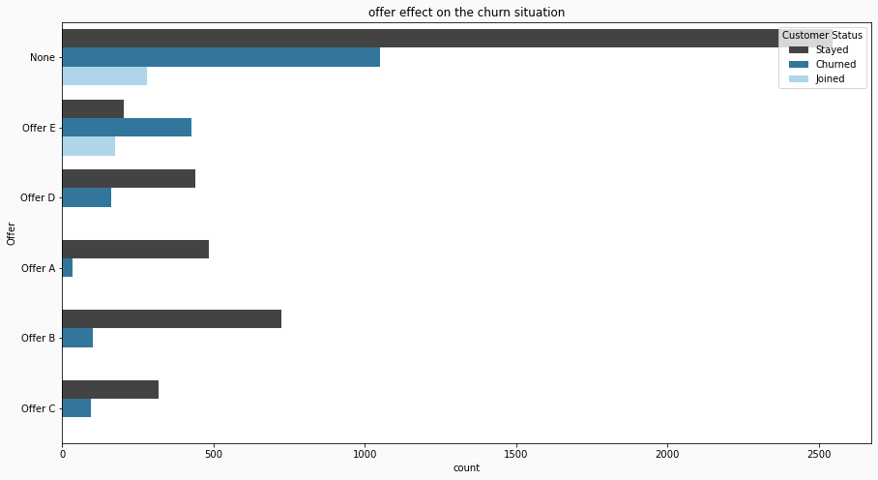
It seems that Offer E appears to make the business clients loss.
q6 How are the offers affected the churn situation?

Slide 14
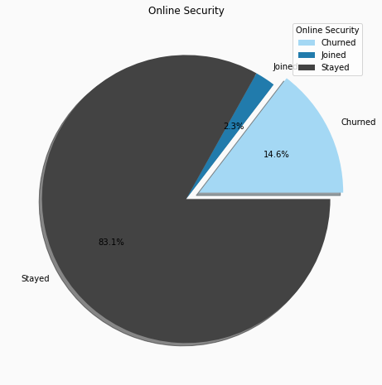
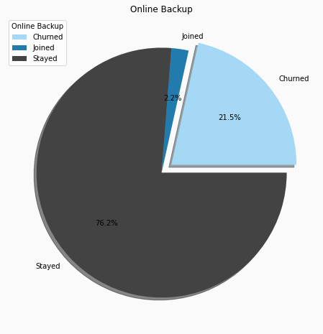

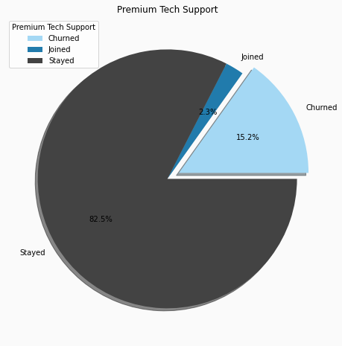
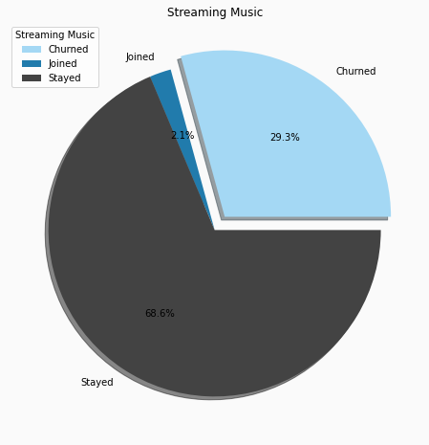


It seems that streaming TV, music, and movie bundles The company should improve these bundles
q7 Services effect on churn situation?

Slide 15
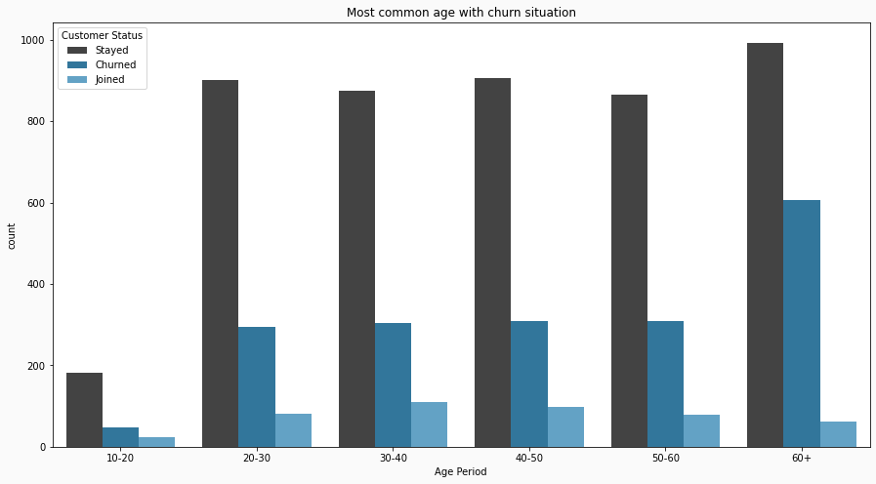
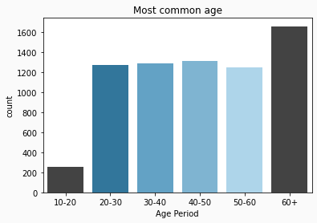
It seems that 60+ age is the common client's age and also is the most ages of churned clients
q8 Most common age?

Slide 16
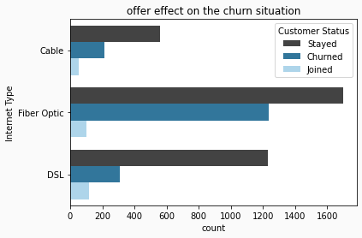
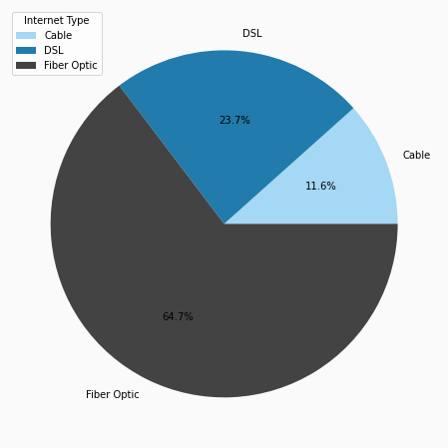
It seems that Fiber Optic is the common clients' internet service and also is the most internet service used by churned clients with a big difference from other services
q9 internet type effect on customer satisfaction and revenue?

Slide 17
03. data preprocessing
Data preprocessing and handle missing

Slide 18
Data preprocessing
01
Handle missing values
02
Detect and Handle Outliers
03
Work with Categorical data
04
Split data to Train and Test Sets
06
Feature Scaling
05
Deal with Imbalanced data

Slide 19
THANKS

